Slide 1
Ad_Hoc Insights Consumer Goods
Challenge:
Provide Insights to Management in Consumer Goods Domain
By: Aakriti Neupane

Slide 2
Description:
Atliq Hardwares (imaginary company) is one of the leading computer hardware producers in India and well expanded in other countries too.
However, the management noticed that they do not get enough insights to make quick and smart data-informed decisions. They want to expand their data analytics team by adding several junior data analysts. Tony Sharma, their data analytics director wanted to hire someone who is good at both tech and soft skills.
Hence, he decided to conduct a SQL challenge which will help him understand both the skills.

Slide 3
Task
There are 10 ad hoc requests for which the business needs insights.
Run a SQL query to answer these requests.
Make a presentation to show the insights.

Slide 4
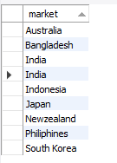
1.Provide the list of markets in which customer "Atliq Exclusive" operates its business in the APAC region.

Slide 5

2. What is the percentage of unique product increase in 2021 vs. 2020? The final output contains these fields, unique_products_2020 unique_products_2021 percentage_chg
Productions was increased by 36.33% in 2021 compared with 2020.

Slide 6
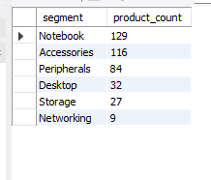
3. Provide a report with all the unique product counts for each segment and sort them in descending order of product counts. The final output contains 2 fields, segment product_count

Slide 7
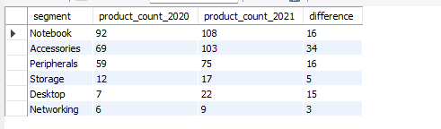
4. Which segment had the most increase in unique products in 2021 vs 2020? The final output contains these fields, segment product_count_2020 product_count_2021 difference
Segment “Accessories” had the most increase in unique products in 2021 vs 2020.

Slide 8

5. Get the products that have the highest and lowest manufacturing costs. The final output should contain these fields, product_code product manufacturing_cost
Highest = AQ HOME Allin 1 Gen 2
Lowest = AQ Master wired x1 Ms

Slide 9
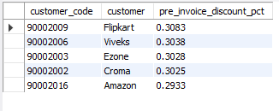
6. Generate a report which contains the top 5 customers who received an average high pre_invoice_discount_pct for the fiscal year 2021 and in the Indian market. The final output contains these fields, customer_code customer average_discount_percentage

Slide 10
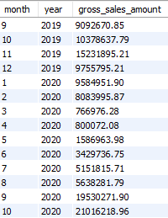
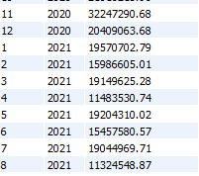
7. Get the complete report of the Gross sales amount for the customer “AtliqExclusive” for each month. This analysis helps to get an idea of low and high-performing months and take strategic decisions. The final report contains these columns: Month Year Gross sales Amount

Slide 11
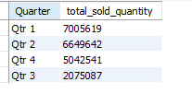
8. In which quarter of 2020, got the maximum total_sold_quantity? The final output contains these fields sorted by the total_sold_quantity, Quarter total_sold_quantity
Fiscal year of company starts from September and first three months (sept, oct, nov) got the maximum total sold quantity.

Slide 12

9. Which channel helped to bring more gross sales in the fiscal year 2021 and the percentage of contribution? The final output contains these fields, channel gross_sales_mln percentage
Channel “Retailer” helped to bring more gross sales in the fiscal year 2021 with 73% contribution.

Slide 13
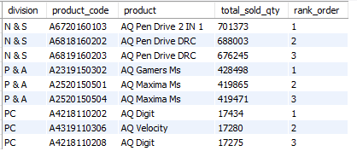
10. Get the Top 3 products in each division that have a high total_sold_quantity in the fiscal_year 2021? The final output contains these fields, division product_code

Slide 14
Thank You!

